Slide 1
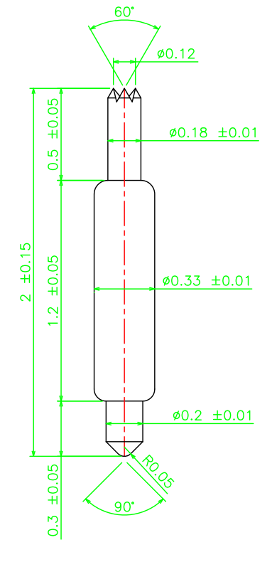
※ High speed POGO pin – 2.0mm / 0.4P
IVB-DAR-200-033-A226-00
Pitch | 0.4mm
Total Length | 2.0mm
Use Length | 1.7mm
Use stroke | 0.3mm
Spring Force at Use Stroke | 16gf at 0.3mm Stroke
Operating Temperature | -40 to 125°C
DC Resistance | Avg. 90.0mΩ at 0.3mm stroke
Current Rating (Continuous) | 0.5 A
Self Inductance | TBD
Bandwidth @ -1dB | TBD
Insertion Life | 100,000 cycles

